Slide 1

CPE 490 Embedded Systems Lecture 9
Arrays
Pointers
Schildt, Herb. 1989. ANSI C Made Easy. Computing Mcgraw-Hill.

Slide 2
Arrays in C
Array are always contiguous in memory
Lowest address corresponding to the first element
Highest address corresponding to the last element
Single and multidimensional arrays are provided for.
Prototype for single dimension
type var_name[size];
First element is always indexed as [0]

Slide 3
Memory Size of Array
Total bytes = number of bytes in type * number of elements
Example
float FloatArray[12]; // contains 12*4 = 48 bytes

Slide 4
No Assignment Between Arrays
The following is illegal
int a[10], b[10];
a = b;
You must assign each value individually

Slide 5
NO BOUNDS-CHECKING
C performs no bounds –checking on arrays
Nothing will stop you from overrunning an array
You could write the following and it will compile without incident
main ()
{
int crash[10], i;
for (i=0; i<100; i++) crash[i] = i;
}
Notes:
This will happily write values over existing variable values.
Why no checking? Because C is a intermediate language suppose to run fast bounds checking will slow code down.

Slide 6
Multi-Dimensional Arrays
Prototype
type name[size1][size2]… [sizeN];
Example of two dimensional array
int twod [10] [20]; // two dimensions array
twod[3][5] = 52; //using the array
In the above example 10 X20 X2 = 400 bytes used
Notes:
What would C construct would you use to have a multi dimension array that had an integer and a floating type.

Slide 7
Two Dimensional Array in Memory
In two dimension think of first index as row and second as column. Lowest memory will contain row 0, column 0, next will be row 0, column 1, and so forth.
for example int arrtype[2][3]; will be in memory lowest to highest as 00, 01,02,10, 11, 12.
Notes:
If you have a multidimensional array be careful you can use up all your memory.

Slide 8
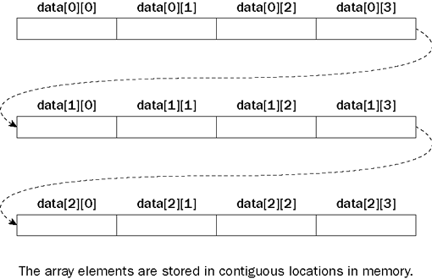
Two Dimensional Array in Memory
char data [3] [3];
Notes:
If you have a multidimensional array be careful you can use up all your memory.

Slide 9
Strings
A string in C is a char single dimension array that end in the null character.
The null character can be represented as ‘\0’ or it can just have a value of zero.
Therefore you must declare the array one longer than the text string you would like to store. For example to contain “Hello” you would need an array of 6 not 5.
Notes:
More on strings in a later lecture

Slide 10
Array Initialization
Prototype is
Type-specifier array_name[size1]… [sizeN] = {value-list};
Example
int i[10] = {1, 2, 3, 4, 5, 6, 7, 8, 9, 10};

Slide 11
Multi Dimensional Array Initialization
int sqrs[10][2] = {
1,1,
2,4,
3,9,
4,16,
5,25,
6,36,
7,49,
8,64,
9,81,
10, 100
};
 | 0 | 1
0 | 1 | 1
1 | 2 | 4
2 | 3 | 9
3 | 4 | 16
4 | 5 | 25
5 | 6 | 36
6 | 7 | 49
7 | 8 | 64
8 | 9 | 81
9 | 10 | 100
Notes:
Same syntax as before just using carriage returns and white space to our advantage.

Slide 12
String Initialization
prototype
char array_name[size] = “string”;
Example
char str[6] = “hello”;
Same as
Char str[6] = {‘h’, ‘e’, ‘l’, ‘l’, ‘o’, ‘\0’};
Notes:
That is the double quotes form automatically adds a null character.

Slide 13
Unsized Array Initializations
It can become tedious counting characters in a string.
Therefore C provides away to automatically load the size of an array.
Examples
char e1[] = “Toy boat”;
int intarray[]= {1,2,3,4};
Notes:
e1 is an array 9 characters

Slide 14
Pointers in C
A pointer is a variable that contains a memory address. So a pointer, points to a memory location (like another variable).
The general from of declaration
type *var-name;
Examples
int *p; // this is a pointer to an integer
float *p; //this is a pointer to a float

Slide 15
Pointer Operators & and *
Unary operator &
In the example &X it means: address of X
Has high precedence of 2
Unary operator *
In the example *X it means: The object or function pointed by X
Also has high precedence of 2
Notes:
The highest precedence is for things like paranthesis

Slide 16
Pointer Example
main ()
{
int balance;
int *address;
int value;
balance = 3200;
address = &balance; // address has the address of //balance
value = *address; // value = 3200
}
Notes:
Notice no space in between unary operator and what it operates on.

Slide 17
Assigning Values Using Pointers
Example
Main()
{
int *p, num;
p = &num; /points to the integer num
*p = 100; /num = 100
(*p)++; /num = 101
Notes:
The * operator has lower precedence than the ++ operator hence the use of the paranthesis

Slide 18
A Pointer Error
int main()
{
float x,y;
int *p; // p points to an integer
x=-248.75;//x is assigned an address of 0x080C
p = &x; // p now is 0x080C
y = *p; /* y gets assigned the "integer" of x
since p points to x the lower 2 bytes
read integer 30147(dec) this number is
converted to a float point number that represents 3014 and stored into Y */
Notes:
Good to run this in mplab to illustrate. Note that the compiler does give a warning. It is worth looking at the warnings that are generated.

Slide 19
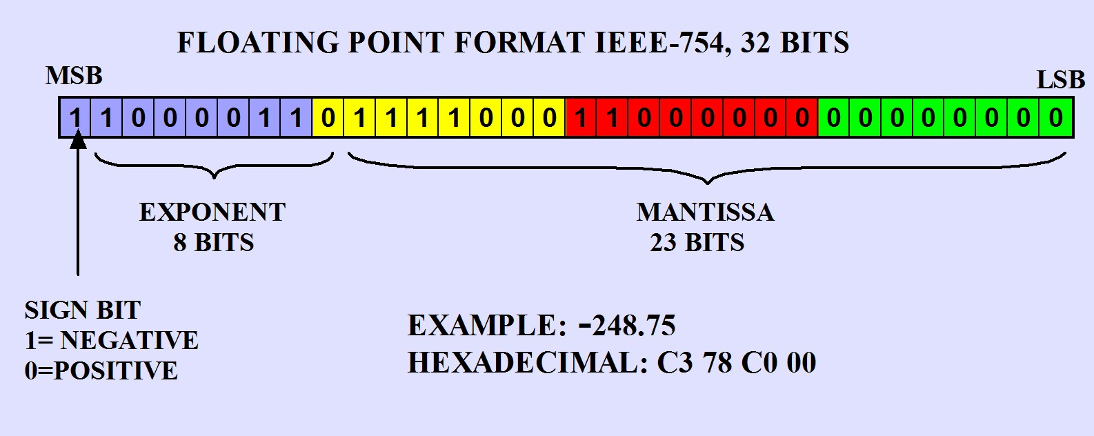
FLOATING POINT REPRESENTATION
IEEE-754 format

Slide 20
Floating Point
Exponent value always subtract 0x7F
Mantissa always has an implicit one to make the 24 Msbit This one is left of the binary point (1.0)
MSB is always a sign bit

Slide 21
Floating Point
248 d = 0xF8 (requires the binary point to be shifted 7 places. 0x86-0x7F = 7
23-7=16 binary digits are available to the right of the binary point 2^16 * .75 =49152 = 0xC000
Notes:
1 1000 0110 1111 1000 1100 0000 0000 0000
1100 0011 0111 1000 1100 0000 0000 0000
C 3 7 8 C 0 0 0

Slide 22
Pointer Arithmetic
The following operators are allowed
++, +, --, -
Addition or subtraction to address will happen in the size of the type of pointer
Example:
int *pl,x; // say x is at adress 0x4320
pl = &x;
pl++; // now pl points to 0x4322 not 0x4321
pl = pl-5; // now pl points to 0x4312 not 0x 4317
Notes:
Do class demonstration in mplab pointer math

Slide 23
Pointers and Arrays
In C, using the name of an array without and index generates a pointer to the first element of the array.
Example
char str[80], z;
char *pl;
pl = str; // legal statement
z= str[4]; //z gets the 5th character
z= *(pl+4); // same result as previous statement
Notes:
This is important because pointer arithmetic like in the second statement can be faster than indexing the array in the first statement

Slide 24
Faster Code by Pointer Math
From previous
z= str[4]; //z gets the 5th character
z= *(pl+4); // same result as previous statement
The first way will require a base address to have 4 added to it.
The second will require a pointer to be incremented 4 times ( a shift of 2). This can be faster way to get a value out of an array

Slide 25
Call by Value
Call by value: When an argument is passed to a subroutine, it is a copy of the variable used, the actual variable that is used in the call does not change. For example:
main() sqr_it(int x)
{ {
int t=10,y; x=x*x;
y=sqr_it(t) return(x);
} }
At the end of main the value of t is 10 not 100

Slide 26
Call by Reference
Call by reference: allows the call variable to be changed by the function. In C this is accomplished by passing a pointer to the variable instead of a copy of the variable data.
swap(int *x, int *y) Example of a call to swap:
{ main()
int temp; {
temp = *x; int x=10, y=20;
*x=*y; swap(&x, &y);
*y=temp; }
}

Slide 27
Problems with Pointer – Unitialized
A pointer gone ‘wild’ can write anywhere causing very nasty bugs
This code is very bad
main() // this program is wrong
{
int x, *p;
x = 10;
*p = x;
}

Slide 28
Problem with Pointers Misunderstand
Example of misunderstanding in code
main ()
{
int x, *p;
x = 10;
p = x; /* you think p now points to x but instead p points to address 10 */
}

Slide 29
Pointer and Structures
You can declare a pointer to a structure for example
struct bal{
float balance;
char name[80];
} person;
struct bal *p;
p = &person
p-> balance = 52.75;
Notes:
To dereference structures use the arrow operator.

